Slide 1

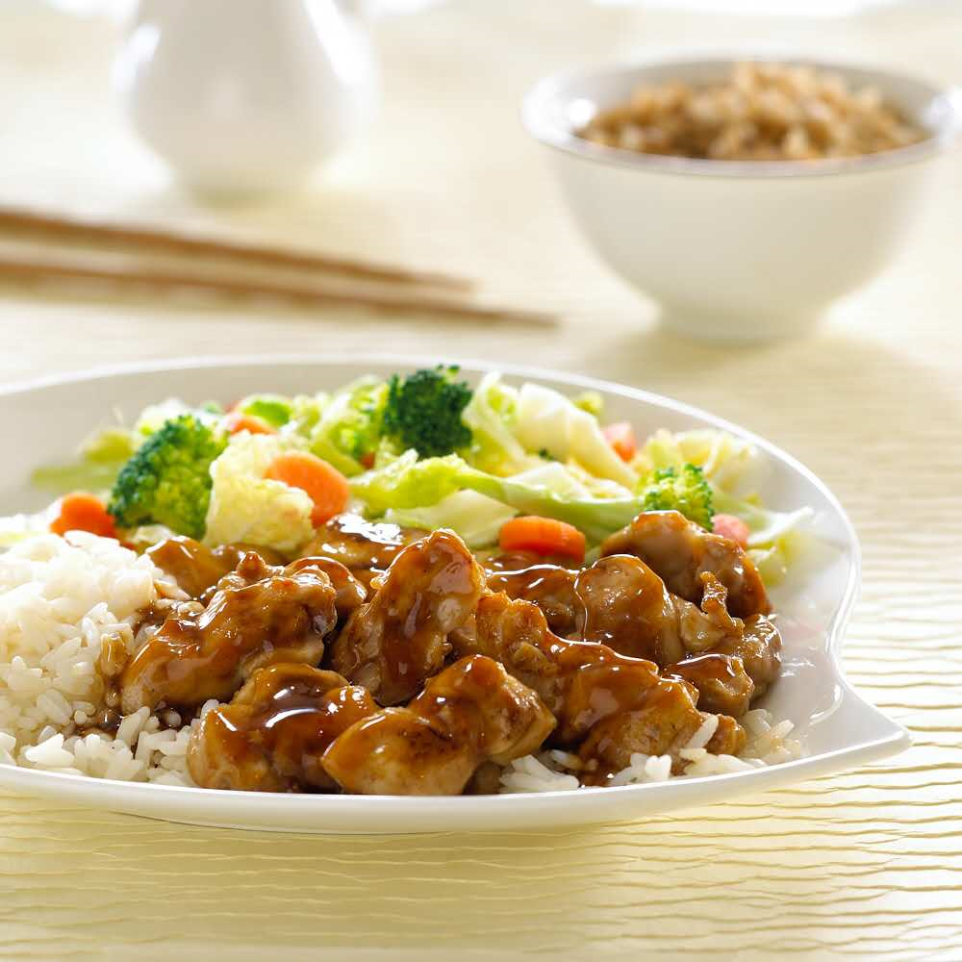

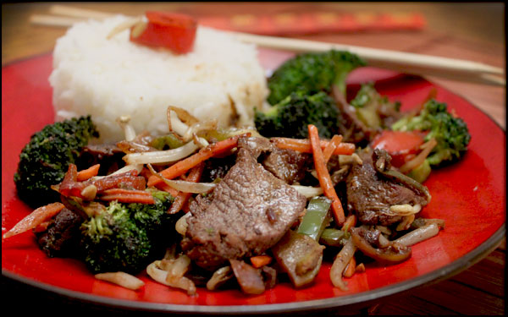

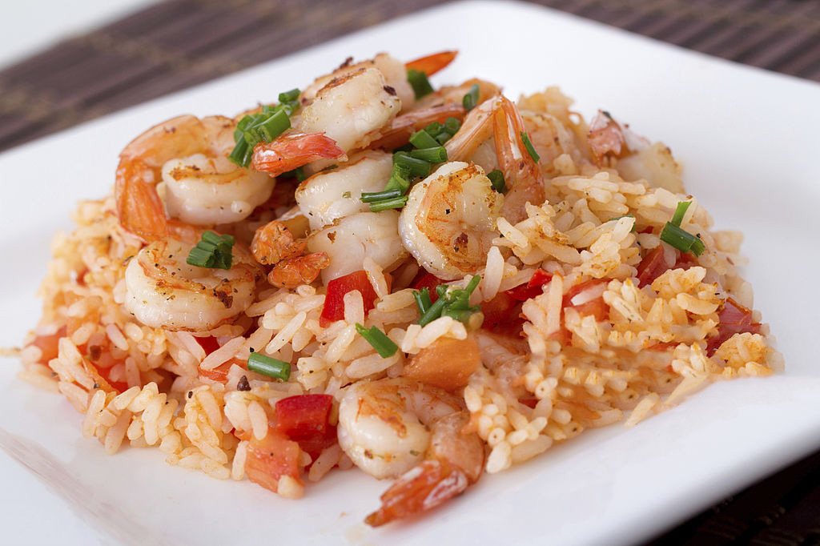
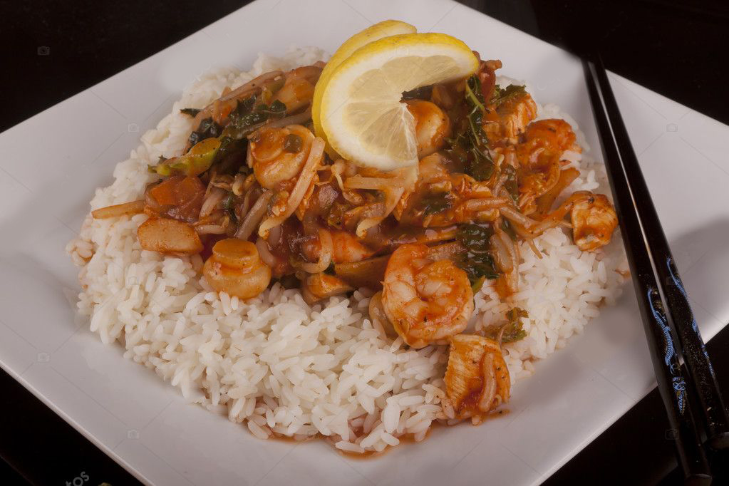
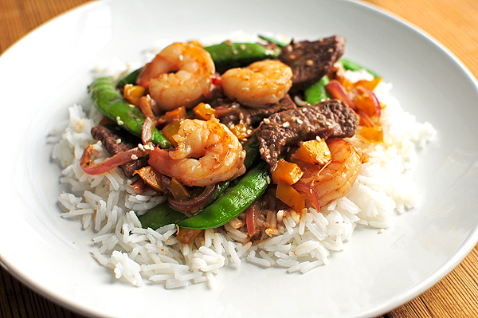

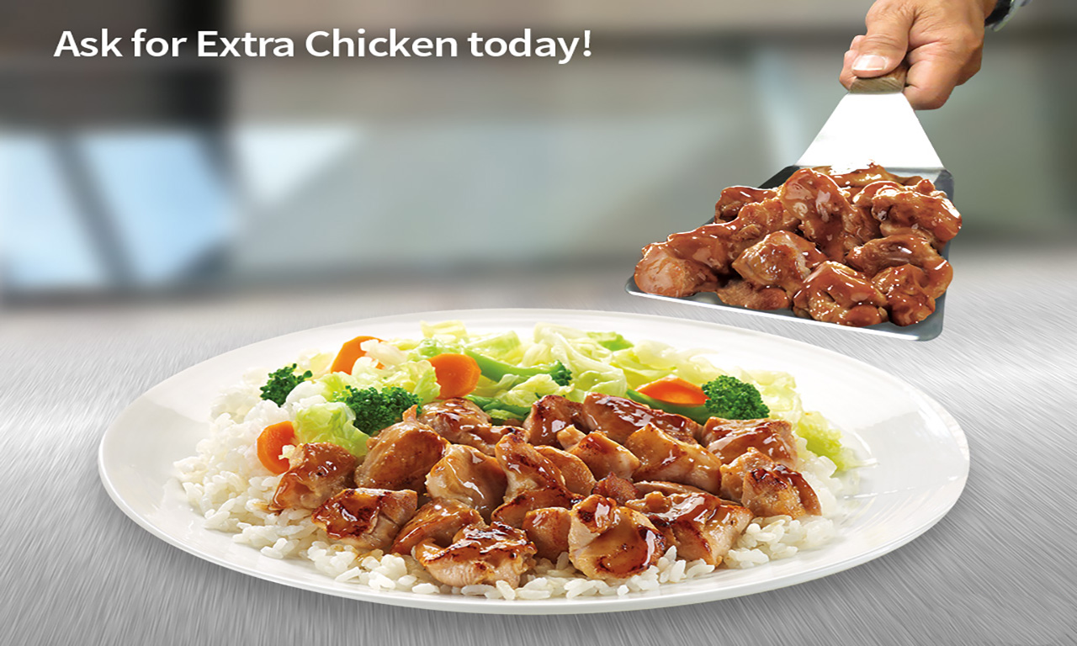

SPECIAL OF THE DAY
TERIYAKI
SERVED WITH: • Steamed Rice • Mixed Vegetables
1
2
3
4
Chicken Teriyaki
640 Cal
6.69
6.39
SERVED WITH: • Mixed Vegetables • Steamed Rice
5
Substitute Steamed Rice with
Fried Rice
Add 20 Cal 50¢
or
Noodles
Add 230 Cal 50¢
Extra Chicken
(4 oz.) 170Cal
1.69

Slide 2



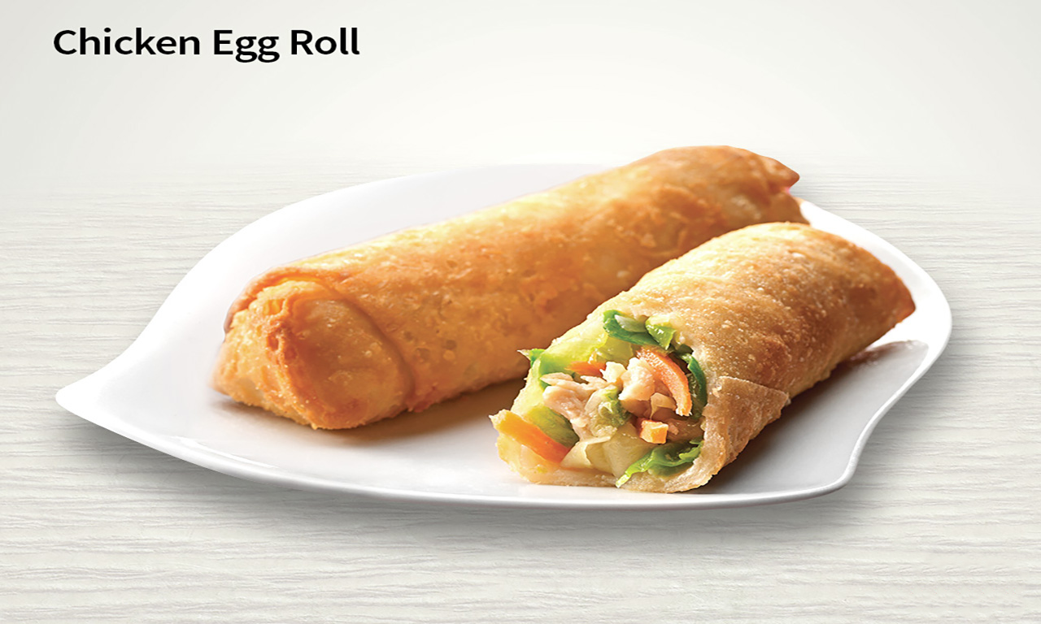

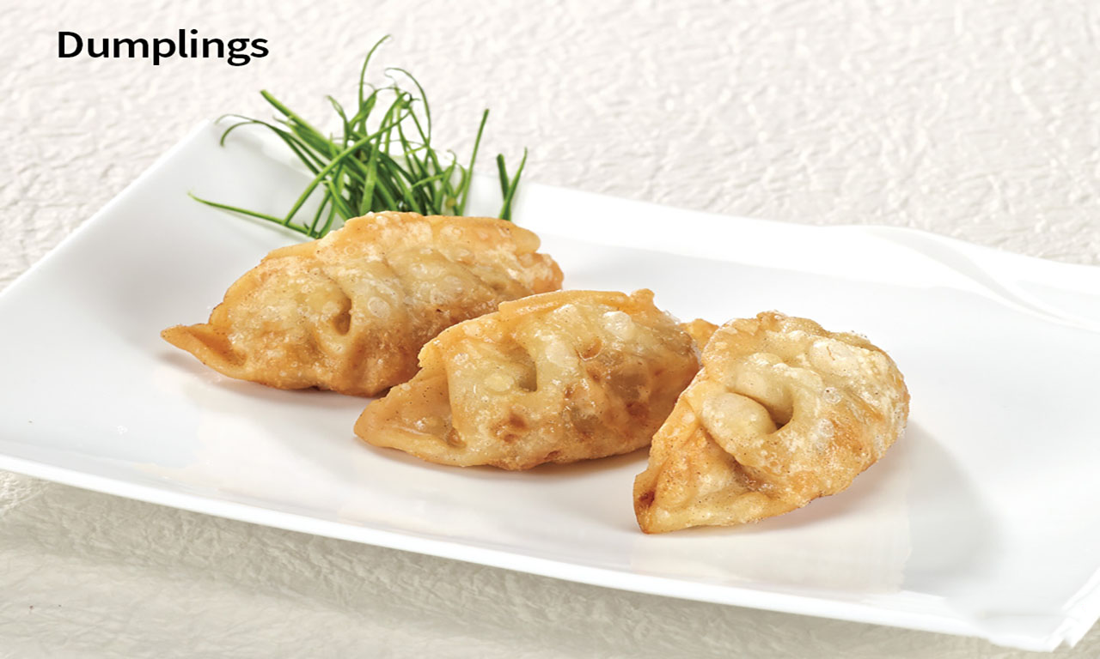
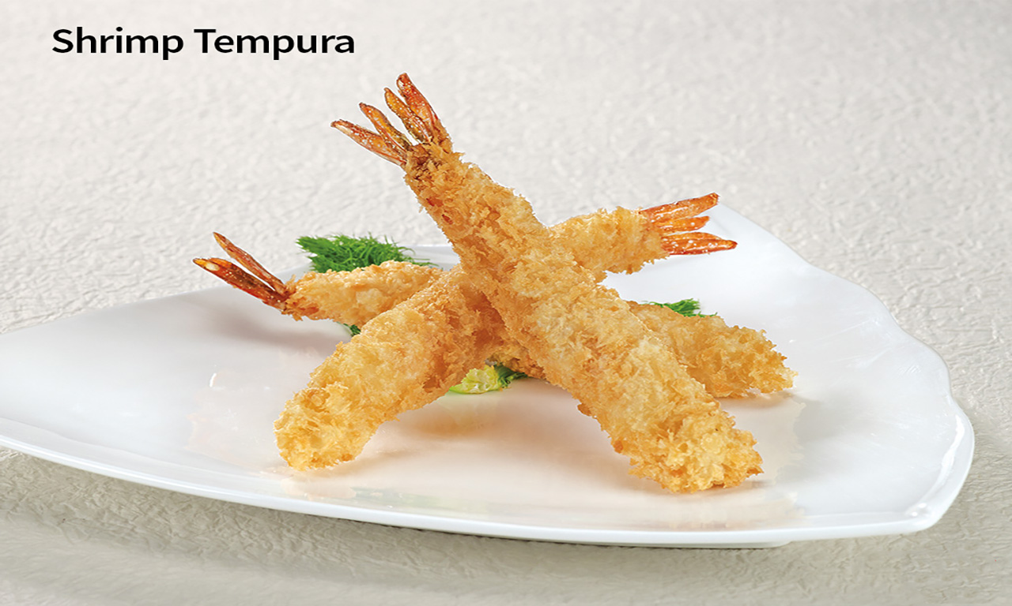




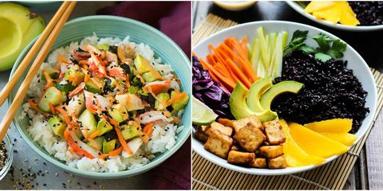

SIDE ORDERS
BEVERAGES
Coke Drinks | Small 0-260 Cal 1.79
 | Regular 0-380 Cal 1.99
Lemonade | 190-250 Cal 1.99
Bottled Water | 0 Cal 1.19
Hot Green Tea | 0 Cal 1.19
Bottle Drink | 10-230 Cal 2.19
190 Cal
0.99
160 Cal
1.39
260 Cal
2.49
390 Cal
3.59
VEGETARIAN
Mixed vegetables & steamed rice
3.49
410 Cal

Slide 3
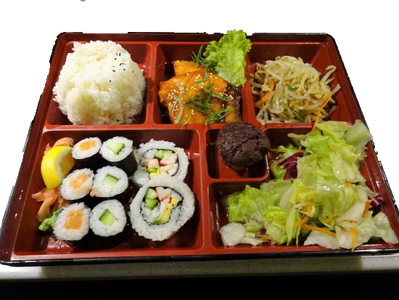



BENTO BOX
Chicken Bento | 930 Cal 8.19
Beef Bento | 810 Cal 8.99
Shrimp Bento | 750 Cal 9.49

